Slide 1
SPATIAL TRANSCRIPTOMICS
The Mosaic of Resistance: Decoding the Dual-Barrier Mechanism of Immune Exclusion in ER+ Breast Cancer
A Spatial Analysis using 10x Genomics Visium
Mahima Mahabaleshwar Siddheshwar
MS Bioinformatics · Indiana University Indianapolis · Python · Scanpy v1.12 · Squidpy v1.8.1

Slide 2
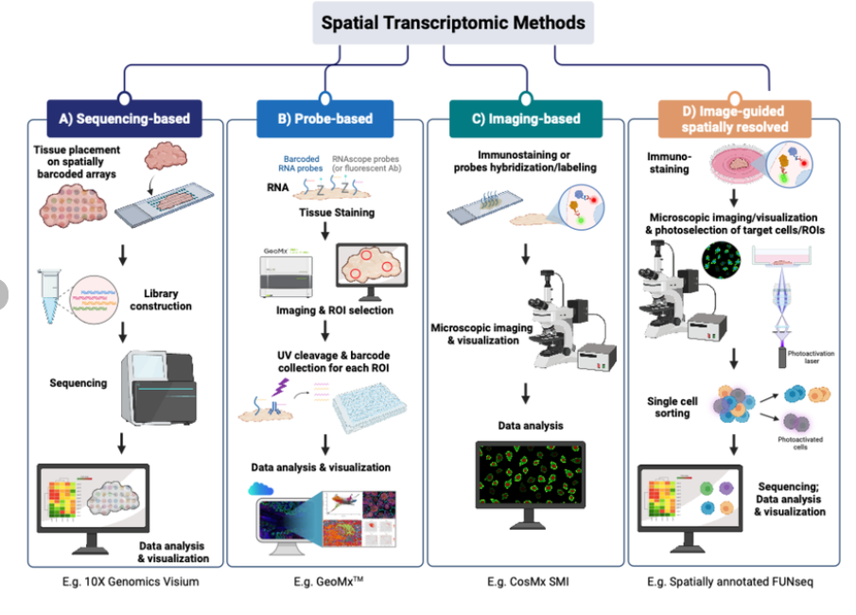
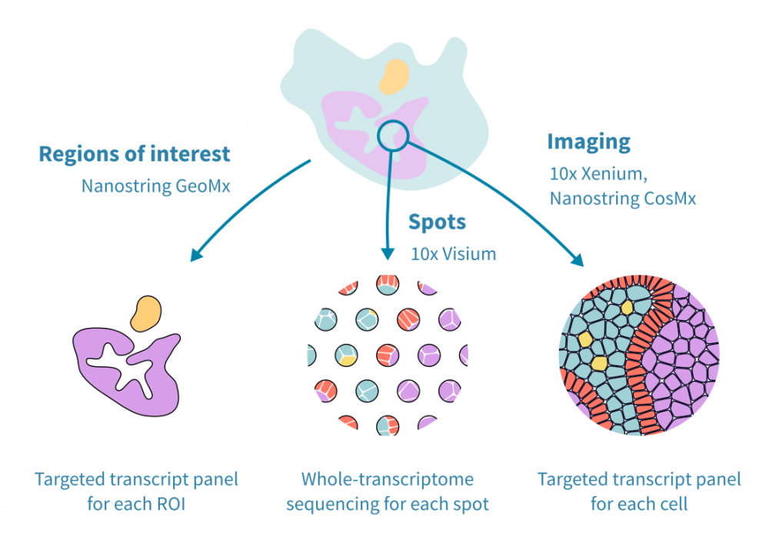
WHAT IS SPATIAL TRANSCRIPTOMICS IN GENOMICS
SPATIAL TRANSCRIPTOMICS
Spatial transcriptomics is a molecular profiling method that maps gene expression (RNA) directly onto tissue sections, preserving spatial context.
Reference: https://geneviatechnologies.com/bioinformatics-analyses/spatial-transcriptomic-data-analysis/
Reference: https://www.researchgate.net/figure/Four-main-types-of-spatial-transcriptomic-methods-Sequencing-based-methods-method-A_fig1_373086296

Slide 3
10x GENOMICS VISIUM — HOW IT WORKS
1
Tissue Section
2
Spot Array
3
mRNA Capture
4
Sequencing
5
Data Matrix
Fresh-frozen breast cancer tissue cryosectioned at 10 μm. Placed on Visium capture slide.
6,500 barcoded spots on slide. Each spot 55 μm diameter. H&E image captured first.
mRNA diffuses from tissue into spots. Each spot captures RNA from ~8 overlying cells.
Spot barcodes + UMIs uniquely identify each molecule. Sequenced by Illumina.
Spots × genes count matrix. Each spot has XY coordinates matching H&E image.
6,500
55 μm
~8 cells
50M+
36,601
spots on slide
spot diameter
captured per spot
total UMI (this study)
genes detected
Notes:
This slide shows how spatial transcriptomics works. Fresh-frozen tissue is placed on a slide with thousands of barcoded spots. Each spot captures mRNA from nearby cells. After sequencing, transcripts are quantified using UMIs, and gene expression is mapped back to spatial locations, creating a high-resolution map of gene activity across the tissue.

Slide 4
RESEARCH QUESTION & OBJECTIVES
CENTRAL QUESTION
Why do immune cells fail to penetrate ER+ breast cancer tumour nests — and can we spatially map the molecular barrier?
O1
Identify TME domains
O2
Map spatially variable genes
Use Leiden clustering to define spatially distinct tissue compartments
Apply Moran’s I on highly variable genes to detect spatial gene expression patterns
O3
Score Cell Type Signatures
O4
Detect Tertiary Lymphoid Structure (TLS)
Estimate enrichment of 24 cell types across spatial spots
Use three independent methods to identify consistent TLS signals
O5
Map the dual immunosuppressive barrier
O6
Confirm ER+ Luminal A subtype
Characterize co-localization of PD-L1/PD-1 signaling and TGF-β-rich stroma
Validate subtype using PAM50 scoring and PROGENy pathway analysis
Notes:
This slide outlines my research question and objectives. The main question is why immune cells fail to penetrate ER-positive tumor regions, and whether we can map that barrier spatially.
To address this, I first identify tumor microenvironment domains, then detect spatially variable genes. Next, I estimate cell-type composition, identify tertiary lymphoid structures, and map immunosuppressive signals. Finally, I validate the tumor subtype.

Slide 5
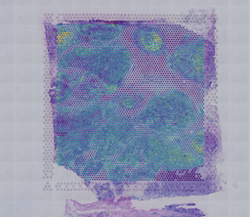
DATASET — 10x GENOMICS VISIUM HUMAN BREAST CANCER
DATASET METRICS
Source
10x Genomics (public)
Platform
Visium v1.3.0
Tissue
Human Breast Cancer Invasive Ductal Carcinoma
INSERT: H&E tissue image with Visium spot overlay
Preparation
Fresh-frozen (FF)
figures/spatial/ · Shows 4,869 georeferenced spots on tissue section
Spots (raw)
4,898
Genes (raw)
36,601
Median UMI/spot
9,720
Median genes/spot
3,654
AFTER QC — FINAL DATASET
Total UMI
50,107,992
Spots retained
4,869 (99.4%)
MT% mean
3.71%
Genes retained
21,349 / 36,601
HB% mean
0.01%
HVGs selected
3,000 (Seurat v3)
Spots removed
29 — dead / low quality
Notes:
HB% of 0.01% — essentially zero blood contamination — confirms exceptional tissue quality. 99.4% spot retention shows the QC filters were appropriate: stringent enough to remove dead cells, but not over-aggressive.

Slide 6
ANALYSIS WORKFLOW — 7-NOTEBOOK PYTHON PIPELINE
01
02
03
04
05
06
07
Data Setup
QC & Preprocess
Clustering
Spatial Analysis
Signature Scoring
Cell Comm.
Advanced
Download · Load · Verify
Filter · Norm · HVG · PCA
Leiden · Annotation
Moran's I · Nhood · Ripley
24 signatures · Heatmap
39 LR pairs · Pathways
PAM50 · PROGENy · Report
PREPROCESSING STEPS
1
Normalize
2
log1p
3
HVG Select
4
Scale
5
PCA
6
kNN + UMAP
7
Leiden
CPM to 10k counts per spot
Natural log transform
3,000 genes (Seurat v3)
Zero-mean, unit variance
50 components computed
k=15, 30 PCs used
Resolution 0.5 selected
DATA FILES CHAIN
adata_preprocessed.h5ad
adata_annotated.h5ad
adata_spatial.h5ad
adata_scored.h5ad
adata_cellcomm.h5ad
Notes:
Data flows between notebooks via .h5ad files. Each notebook has one responsibility. The preprocessing steps in NB02 are ordered: normalization must come before log-transform, log-transform before HVG selection. This ordering is not arbitrary — it matches the mathematical assumptions of each method.

Slide 7
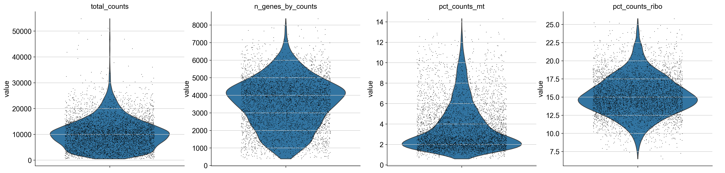
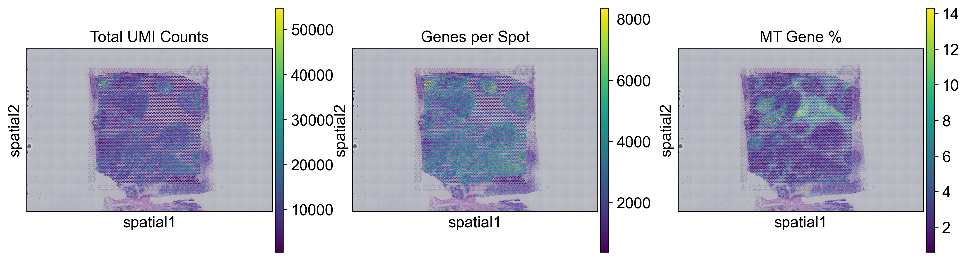
QUALITY CONTROL RESULTS
FILTERS APPLIED
Min 200 genes/spot
Removes empty or dying spots
INSERT: QC Violin Plot — before filtering
figures/qc/violin_01_qc_violin_before_filter.png [total_counts · n_genes_by_counts · pct_mt]
Min 500 UMI/spot
Ensures reliable quantification
MT% < 15%
Excludes lysed/dead cells
Gene in ≥ 3 spots
INSERT: Spatial QC Map on H&E tissue
Removes ultra-rare artefacts
figures/spatial/02_spatial_qc.png [Spot colour = total counts or MT% — reveals spatial quality distribution]
4,898 → 4,869 spots retained (99.4%)
Notes:
filtered out 3 cells that have less than 200 genes expressed
filtered out 26 cells that have less than 500 counts
filtered out 15252 genes that are detected in less than 3 cells
After filtering: 4898 -> 4869 spots; 36601 -> 21349 genes

Slide 8
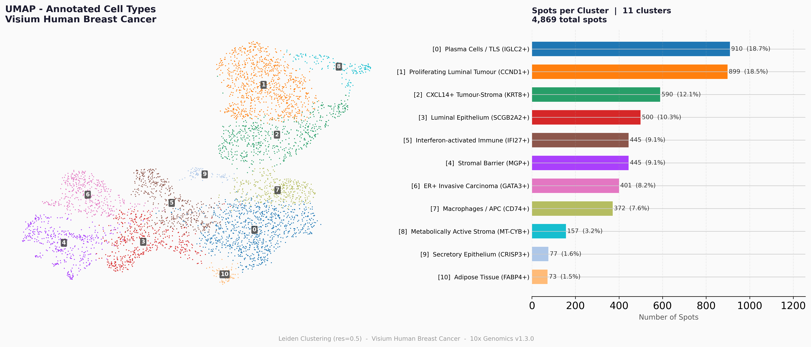
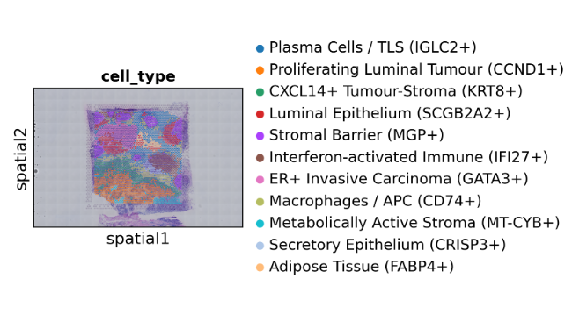
CLUSTERING & CELL TYPE ANNOTATION
INSERT: UMAP coloured by 11 Leiden clusters
INSERT: Annotated Spatial Map on H&E tissue
figures/clustering/07_umap_annotated_pub.png [All 11 clusters labelled]
figures/spatial/08_spatial_annotated_pub.png [Same colours as UMAP — shows spatial organisation]
C0
Plasma Cells / TLS (IGLC2+)
910
C6
ER+ Invasive Carcinoma (GATA3+)
401
C1
Proliferating Luminal Tumour (CCND1+)
899
C7
Macrophages / APC (CD74+)
372
C2
CXCL14+ Tumour-Stroma (KRT8+)
590
C8
Metabolically Active Stroma (MT-CYB+)
157
C3
Luminal Epithelium (SCGB2A2+)
500
C9
Secretory Epithelium (CRISP3+)
77
C4
Stromal Barrier (MGP+)
445
C10
Adipose Tissue (FABP4+)
73
C5
Interferon-activated Immune (IFI27+)
445
Notes:
***Figure Interpretation: Spatial Organization of Tumor Heterogeneity***
This figure validates that the Invasive Carcinoma is not a uniform mass, but rather composed of four distinct tumor cell clusters with unique molecular profiles:
- Proliferating Tumour (Orange): Forms the large, dense mass in the bottom-half of the tissue. (CCND1+).
- Invasive Carcinoma (Pink): Composes the multiple tumor nests in the top-half. (GATA3+).
- Luminal Epithelium (Red): Forms separate tumor "islands." (SCGB2A2+).
- Secretory Cancer (Light Blue): Shows a small, distinct subpopulation. (CRISP3+).
Combined, these four clusters represent the entire "Target" (the cancer core), which is completely delineated and separated from the rest of the stroma by the MGP+ Stromal Barrier (Purple). This map is definitive proof that the tissue is an highly organized, structured ecosystem.

Slide 9
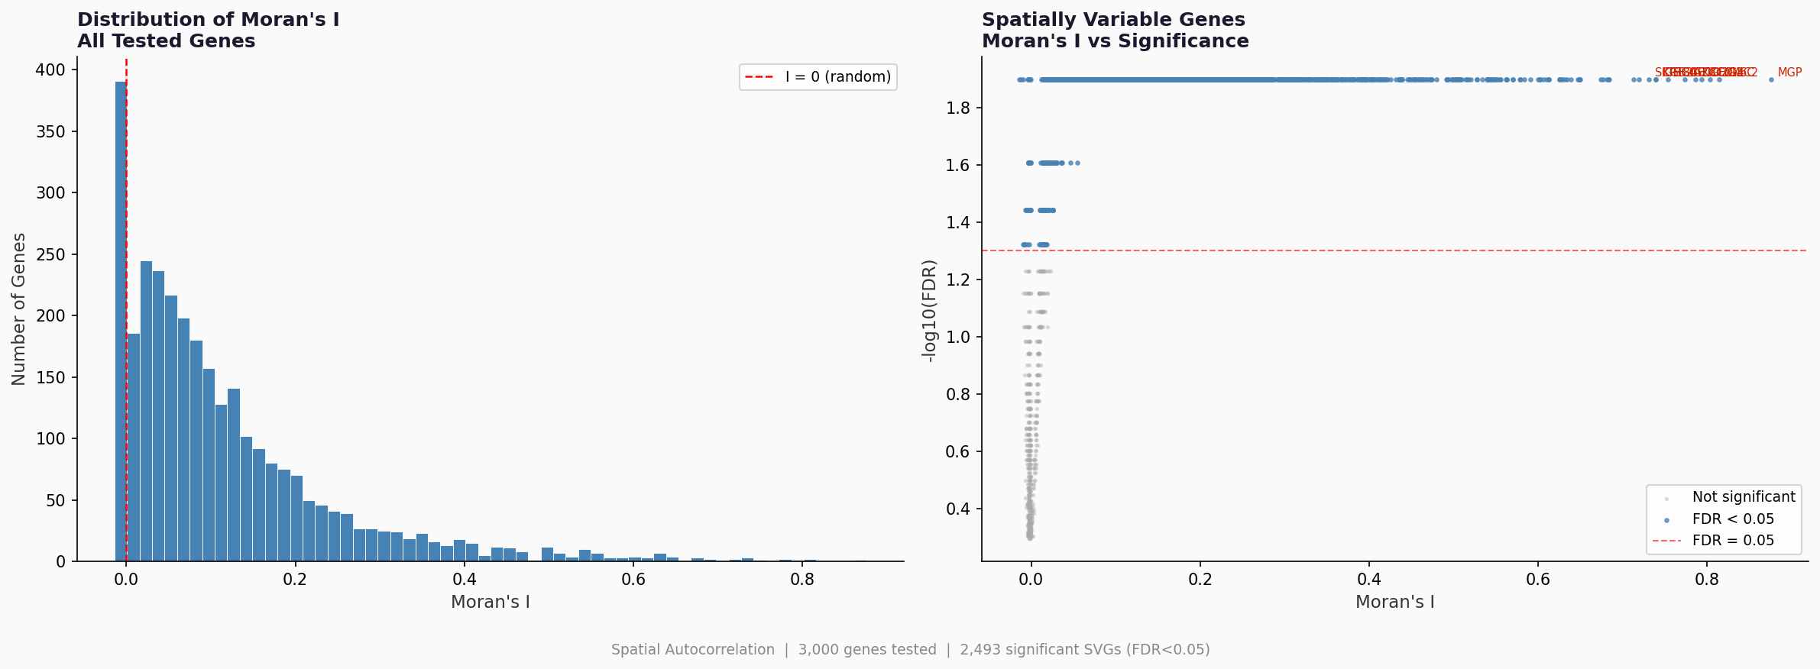
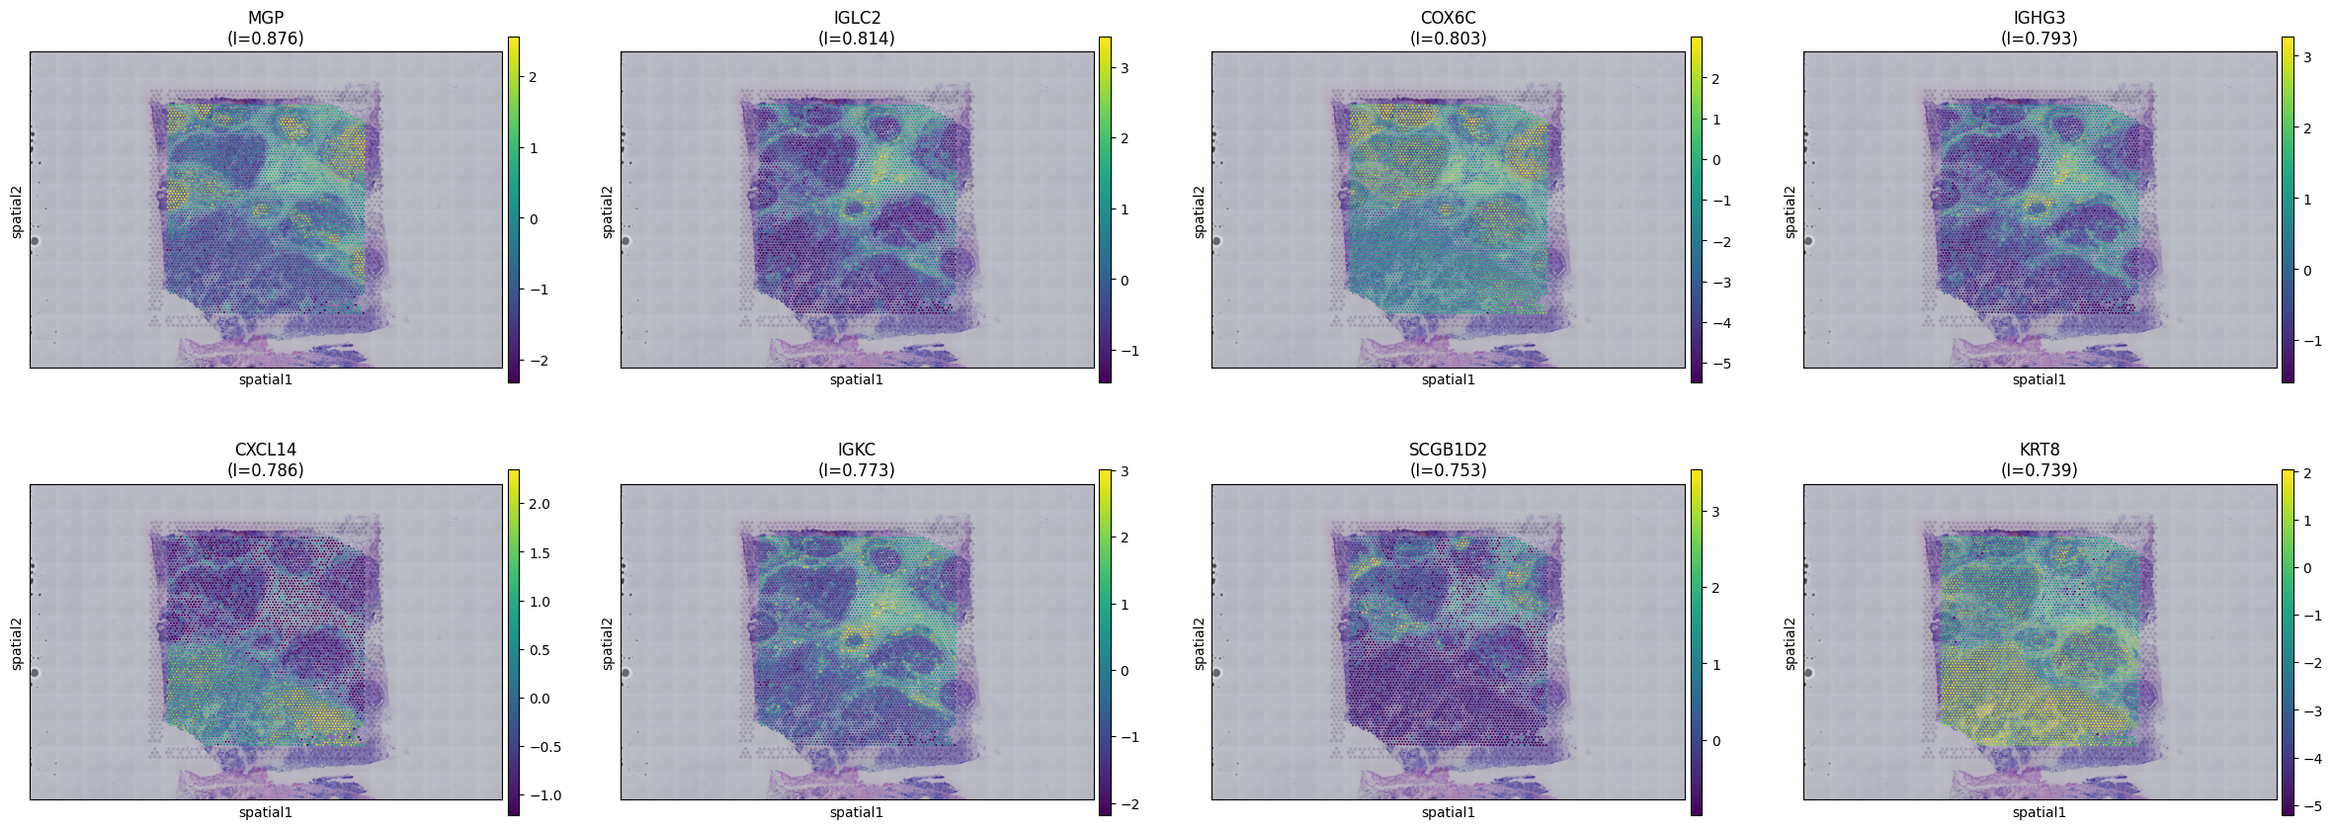
KEY RESULTS: SPATIALLY VARIABLE GENES · NB04
3,000
2,498
genes
tested
significant
(FDR < 0.05)
INSERT: Moran's I Summary (2-panel)
figures/svg/02_moranI_summary.png
Left: histogram of I values across 3,000 genes | Right: I vs -log10(FDR) scatter
TOP SPATIALLY VARIABLE GENES – MORAN`S I
#1 MGP
I=0.876
STROMA
#2 IGLC2
I=0.815
TLS★
#3 COX6C
I=0.803
TUMOUR
#4 IGHG3
I=0.793
TLS★
#5 CXCL14
I=0.786
STROMA
INSERT: Top 8 SVGs spatial maps
#6 IGKC
I=0.773
TLS★
figures/svg/01_top_svgs_spatial.png
8-panel grid — each gene coloured on H&E tissue, title = gene name + I score
#7 SCGB1D2
I=0.753
LUMINAL
#8 KRT8
I=0.739
TUMOUR
Notes:
TLS SIGNAL: Immunoglobulins IGLC2, IGHG3, IGKC rank #2 #4 #6 — all made exclusively by plasma cells — concentrated in the same perivascular tissue zone. First independent TLS evidence.
With this I also validated the TLS structure with other methods like Neighborhood enrichment and Ripley L stats analysis confirmed that all eleven cell type clusters show positive L values — meaning every cluster is more spatially organised than random chance predicts.
This is biologically meaningful as it confirms that the tumour forms dense concentrated nests and that the plasma cells are genuinely organised into a spatially coherent structure consistent with a Tertiary Lymphoid Structure.

Slide 10
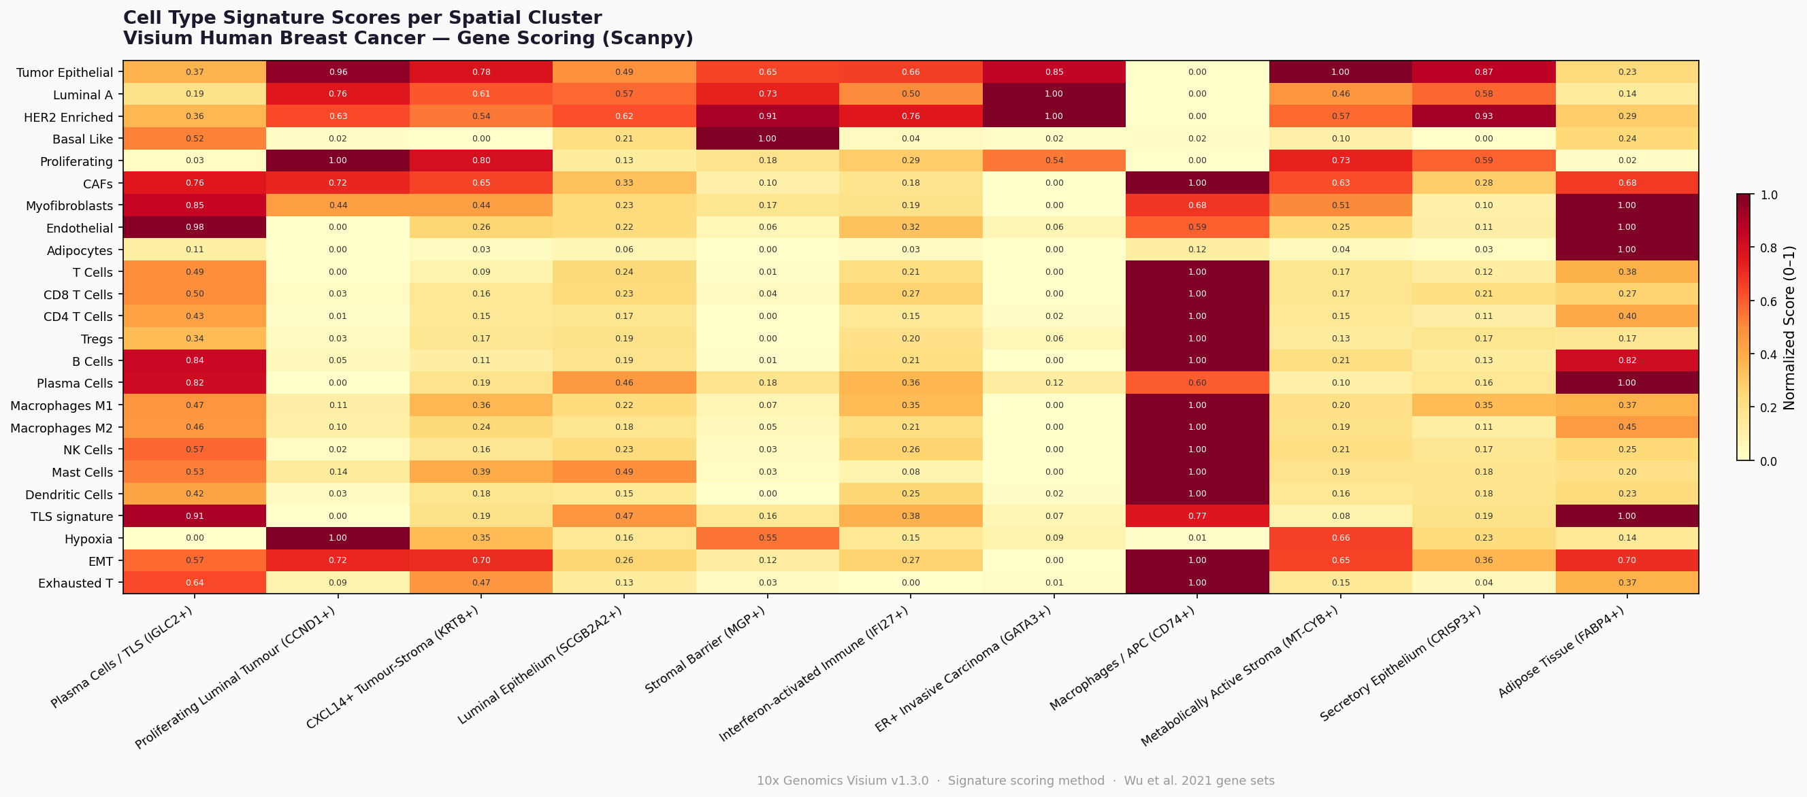
KEY RESULTS: IMMUNE EXCLUSION & TLS · NB05
IMMUNE EXCLUSION — EVERY IMMUNE CELL TYPE SCORES ZERO IN TUMOUR CORE
Cell Type
Peak Cluster
Tumour Core Score
Status
T Cells
Macrophages/APC
~0.00
EXCLUDED
CD8+ T Cells
Macrophages/APC
~0.00
EXCLUDED
NK Cells
Macrophages/APC
~0.00
EXCLUDED
B Cells
Macrophages/APC
~0.00
EXCLUDED
Plasma Cells
TLS Zone
0.82
TLS ZONE
Notes:
This heatmap is the single most information-dense figure in my project. Reading across rows shows where each cell type is enriched and reading down columns shows the complete biological identity of each cluster. Three findings stand out.
- First, the ER+ Invasive Carcinoma column shows Luminal A score of 1.00 confirming the molecular subtype, but all immune scores near zero numerically proving immune cells are absent from the tumour core.
- Second, the Macrophages/APC column shows every immune signature at exactly 1.00 all immune cells are maximally concentrated at this boundary cluster quantitatively confirming immune exclusion.
- Third, the Plasma Cells/TLS column shows TLS signature at 0.91, B cells at 0.84, and plasma cells at 0.82 simultaneously three independent TLS markers co-enriched in the same cluster.
The heatmap essentially summarises my entire project in one figure where the tumour is, where immune cells are blocked, and where the TLS has formed.

Slide 11
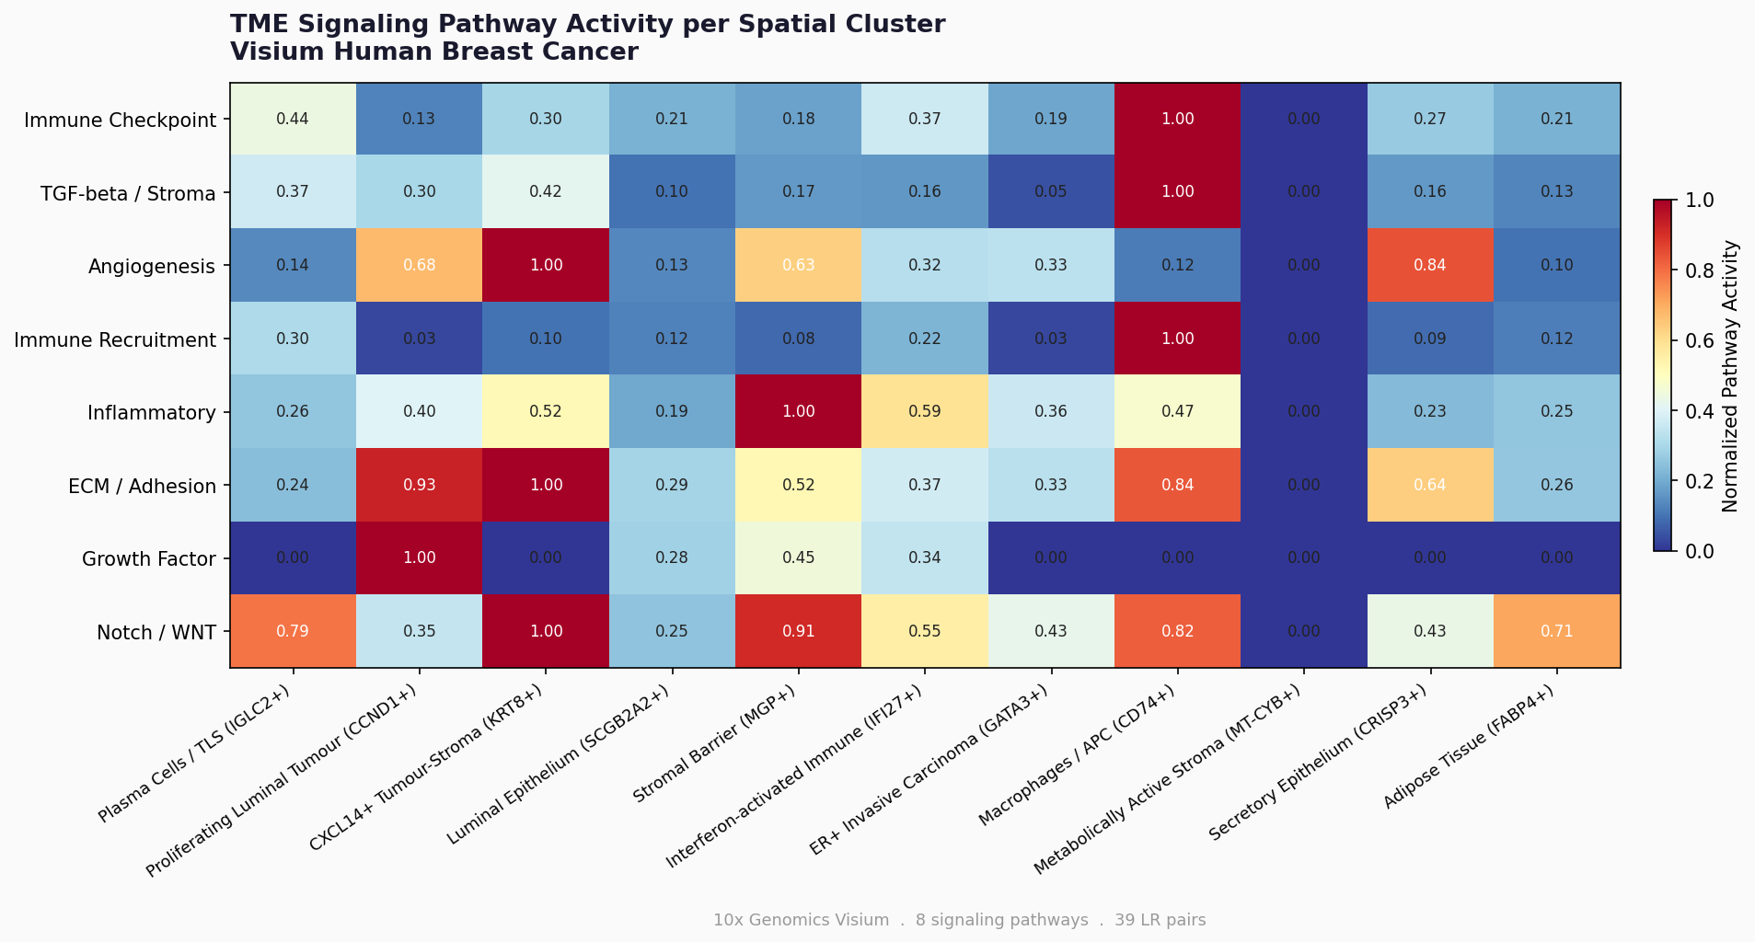
KEY RESULTS: DUAL IMMUNOSUPPRESSIVE BARRIER · NB06
39 curated LR pairs · 8 TME pathways
LOCK 1 — IMMUNE CHECKPOINT (The Shield)
LOCK 2 — TGF-β STROMAL BARRIER (The Wall)
PD-L1 → PD-1
TGFβ1 → TGFBR1 / TGFBR2
Tumour cells express PD-L1. Binds PD-1 on T cells. Functionally switches off cytotoxic response. T cell is PRESENT but cannot fire — deactivated at point of contact.
CAFs secrete TGF-β. Stiffens extracellular matrix. Physically blocks T cell migration. T cell WANTS to fight — but cannot pass through the stromal wall.
Also: CD80→CTLA4 · LAG3→MHC-II · TIGIT→PVR
FN1→ITGB1 (score 1.06 — highest) · COL1A1→ITGA1 · POSTN→ITGAV
LOCK 3 — TLS RECRUITMENT (The Wall)
CXCL13 → CXCR5
Spatial barriers and macrophage signaling drive "patchy" immune-excluded tumor resistance
Also: CXCL12→CXCR4
Notes:
This heatmap perfectly maps the "Spatial Standoff." It shows the immune system is recruited to the Macrophages (the border), but is blocked by the Stroma (the wall) and never reaches the Carcinoma (the target).

Slide 12
KEY RESULTS: IMMUNE EXCLUSION & TLS
3 INDEPENDENT TLS CONFIRMATIONS — SAME TISSUE LOCATION
01
Moran's I (NB04)
02
Cell Scoring (NB05)
03
LR Communication (NB06)
IGLC2 #2, IGHG3 #4, IGKC #6
Plasma cell score = 20.9 (peak)
CXCL13→CXCR5 confirmed p<0.001
All plasma cell markers
B cell enrichment same zone
500 permutation validated
Spatially concentrated — not scattered
TLS signature (CXCL13, CCL19) co-enriched
THE canonical TLS-building chemokine
FDR < 0.05 · 100 permutations
5× higher than any other immune type
Found in same perivascular zone
Notes:
The categorical immune exclusion is the most compelling slide in the project. Every cytotoxic immune cell — T, CD8, NK, B — scores ZERO in the tumour core. Immune cells are present in the tissue but spatially excluded from the cancer cell nests. Plasma cells are the exception because they are in the TLS, not excluded — they score highest of all immune types.

Slide 13
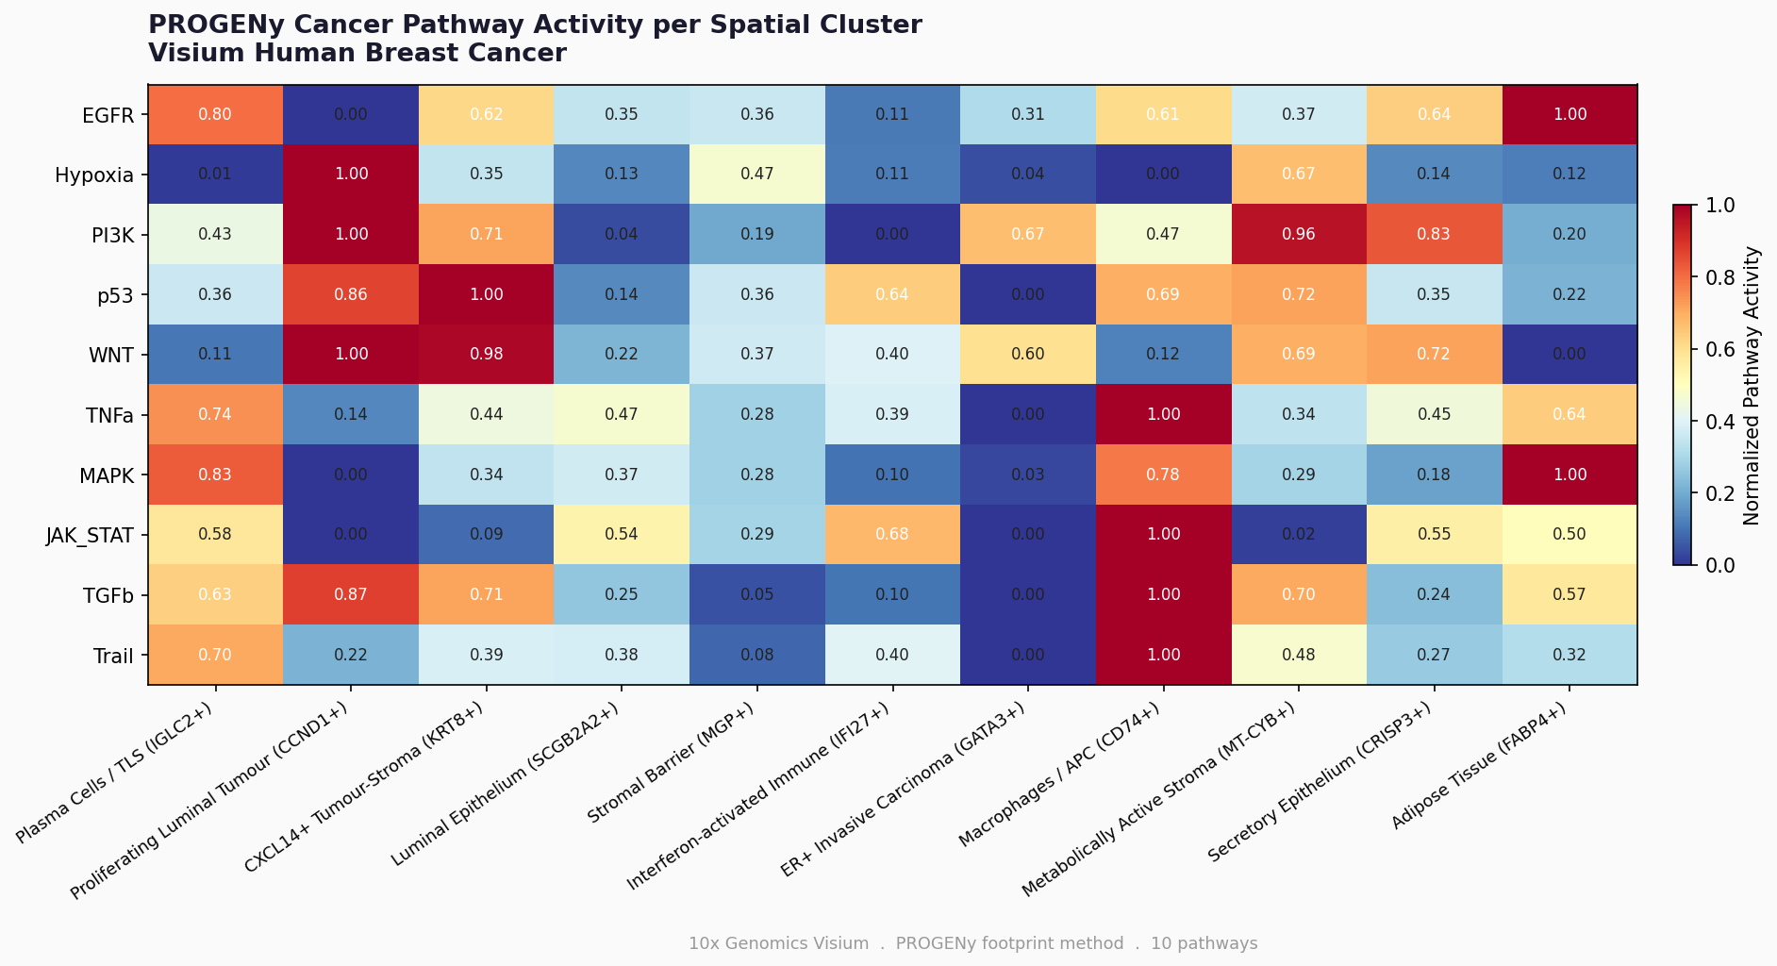
MOLECULAR SUBTYPE & PATHWAY VALIDATION · NB07
PAM50 MOLECULAR SUBTYPING
PROGENy PATHWAY ACTIVITY
Clinically validated 50-gene classifier · Scored per Visium spot spatially
Downstream target gene footprints · More reliable than measuring pathway genes directly
Luminal A
2815
ER+ Invasive Carcinoma (GATA3+)
Normal
672
Proliferating Luminal Tumour
INSERT: PROGENy heatmap (10 pathways × 11 clusters)
figures/advanced/04_progeny_heatmap_pub.png
Key: TGF-β and Hypoxia peak in stromal/tumour clusters
Basal-like
493
Low — not a HER2+ tumour ✓
Luminal B
468
Essentially absent ✓
TGF-β
Master Architect of fibrotic tissue and stiff stroma
HER-2
421
Hypoxia
Communication Hub for immune-to-tumor signaling
Adipose region only
EGFR
Growth factor signalling active
ER+ Luminal A confirmed spatially
Hormone therapy · Poor immunotherapy response explained
JAK-STAT
IFN response in immune clusters
p53
DNA damage response
Notes:
Spatial subtyping using the PAM50 signature confirmed that the malignant regions are characterized by a Luminal A molecular profile (n=2,815 spots). This clinical validation provides the necessary framework to interpret the Dual Barrier mechanism: we are observing a hormone-driven (Luminal A) carcinoma that has successfully constructed a stromal wall and an immune-checkpoint shield to achieve spatial exclusion.
> The tumor is a Mosaic of Resistance because the Dual Barrier is not applied uniformly. Some regions rely on structural stiffness (MGP/Collagens) to survive, while others utilize immunological exhaustion (JAK-STAT/Macrophages) to maintain the standoff. This patchy distribution is exactly why these tumors are so difficult to treat—you are fighting multiple different 'fortresses' within a single patient

Slide 14
CHALLENGES & SOLUTIONS
01
Cluster Annotation Completeness
02
Hardcoded Cluster Names Across Notebooks
All 11 Leiden clusters must be explicitly annotated. Any NaN propagates — crashing neighborhood enrichment and LR analysis in downstream notebooks.
After re-annotating clusters, old names (e.g. 'Invasive Carcinoma Core EPCAM+ ESR1+') persisted in NB04 co-occurrence and NB06 ligrec plot, causing KeyError at runtime.
FIX: Added all 11 clusters to annotation dictionary. Added cluster_labels = cluster_annotations.copy(). Deleted stale cell_type_colors before each plot.
FIX: Systematic audit of all 7 notebooks. Replaced every hardcoded cluster name. Added cluster existence check before each plot to catch future mismatches.
03
Max vs Mean Score in Summary Table
04
55 μm Resolution Limitation
Max score per cluster inflated by outlier spots at boundaries. Plasma cell max score (4.23) incorrectly attributed to Adipose cluster — one adjacent spot skewing the result.
Each Visium spot captures ~8 cells. Cell type scores reflect relative enrichment not absolute counts. A spot scoring high for carcinoma still contains stromal cells.
FIX: Switched summary to groupby('cell_type').mean().idxmax() — cluster-level mean is biologically representative. Max score kept as secondary statistic only.
FIX: Acknowledged in methods. sc.tl.score_genes returns relative enrichment per spot. Cell2Location probabilistic deconvolution planned as next step for absolute counts.
Notes:
Challenges demonstrate scientific maturity. Challenge 1 shows deep understanding of how AnnData propagates information. Challenge 3 shows statistical rigour — reporting the representative mean rather than the extreme max. Challenge 4 shows honest acknowledgement of platform limitations.

Slide 15
FUTURE DIRECTIONS
01
Cell2Location Deconvolution
Near-term
02
Multi-patient Cohort Validation
Near-term
Replace signature scoring with probabilistic cell type deconvolution. Produces absolute cell counts per spot. Essential for quantifying TLS cellular composition precisely.
Apply pipeline to 10+ ER+ IDC patients with Harmony batch correction. Test whether Dual Barrier Score predicts immunotherapy resistance across patients.
03
Sub-cellular Resolution (Xenium / Visium HD)
Mid-term
04
CODEX Multiplexed Protein Imaging
Mid-term
Upgrade to 2 μm resolution. Resolve TLS internal architecture — germinal centres, HEVs, T cell zones — at single-cell level within the tissue.
Validate PD-L1, TGF-β, and immune markers at protein level. Required for clinical translation — drugs target proteins, not transcripts.
05
TCGA-BRCA Survival Correlation
Mid-term
06
RNA Velocity — T Cell Exhaustion Trajectory
Long-term
Extract spatial immune exclusion score. Correlate with overall survival in TCGA breast cancer cohort. Test whether dual barrier score is an independent prognostic biomarker.
Add scVelo trajectory inference to map T cell exhaustion dynamics across the spatial gradient. Identify optimal intervention timing window before full exhaustion.
Notes:
Order by feasibility: near-term items (01, 02) can start immediately using existing data. Mid-term items (03-05) require new experiments or data access. Long-term (06) is exploratory. The TCGA survival correlation (05) would translate this spatial finding into a clinically usable biomarker.

Slide 16
CONCLUSION
Tertiary Lymphoid Structure Detected — 3 Independent Confirmations
1
Moran's I (immunoglobulins rank 2/4/6) + cell scoring (plasma cells = 20.9, 5× others) + CXCL13→CXCR5 LR communication — all three converge on the same perivascular upper-left tissue zone. Convergent evidence eliminates method-specific noise. TLS is associated with 3-5× improved survival in breast cancer.
Dual Immunosuppressive Barrier Identified — Mechanism of Resistance
2
PD-L1/PD-1 checkpoint (Lock 1) and TGF-β stromal barrier (Lock 2) are BOTH maximally active simultaneously at the tumour-stroma boundary. Every immune cell scores zero in the tumour core. This mechanistically explains the 5-20% PD-1 monotherapy response rate in ER+ breast cancer and directly supports combination anti-PD-1 + TGF-β inhibitor therapy.
ER+ Luminal A Confirmed Spatially — Cross-Validated by Two Methods
3
PAM50 Luminal A = 1.00 in the GATA3+ Invasive Carcinoma cluster. HER2-enriched and Basal-like are essentially absent. PROGENy TGF-β and Hypoxia pathway activity independently cross-validates the LR communication dual barrier finding — demonstrating internal consistency across the full 7-notebook pipeline.
Mahima Mahabaleshwar Siddheshwar · MS Bioinformatics · Indiana University Indianapolis · Scanpy v1.12 · Squidpy v1.8.1
Notes:
Mirror the opening: the three findings directly answer the central question from slide 5. End with the clinical take-away: this project spatially mapped why ER+ breast cancer resists immunotherapy — and the findings directly support a specific combination therapy that is already in Phase II trials.

Slide 17
TRANSCRIPTOMICS ANALYSIS — COMPARISON OVERVIEW
Feature
Bulk RNA-seq
scRNA-seq
Spatial Transcriptomics
Resolution
Tissue average
Single cell
~8 cells per spot
Spatial info
None
None (lost during dissociation)
Preserved — XY coordinates
Throughput
Low cost per sample
Medium
High cost per section
Cell types
Mixed signal
Individual cells
Inferred from signatures
Best for
DE between conditions
Cell type discovery
TME architecture, niches
Upstream tool
HISAT2 / STAR + featureCounts
Cell Ranger / STARsolo
Space Ranger
Downstream
DESeq2 / edgeR / GSEA
Scanpy / Seurat / scVelo
Scanpy + Squidpy
QC metrics
Mapping %, rRNA%
MT%, doublets, nGenes
MT%, HB%, spatial QC
Output
Gene expression table
UMAP + clusters
Spatial cluster map
Limitation
No cell type resolution
No spatial context
~8 cells/spot resolution
Notes:
Comparison slide shows you understand where each technology fits in the ecosystem. Spatial transcriptomics is NOT replacing bulk or scRNA-seq — it is filling the spatial information gap that both lack. End by linking back to your project: your use of spatial transcriptomics was motivated by needing to answer WHERE immune cells are relative to tumour, which neither bulk nor scRNA-seq can answer.

Slide 18
WHAT I BRING TO THE LAB
Transcriptomics Analysis
End-to-end RNA-seq preprocessing (QC → alignment → quantification)
Differential expression & normalization (DESeq2)
Network-based systems analysis (WGCNA)
Single-cell RNA-seq clustering & annotation
Structured & Reproducible Workflows
HPC/SLURM-based scalable pipelines
Metadata integration & batch-aware analysis
Clean documentation & traceable outputs
Organized large-scale genomic datasets
Biological Wet Lab Analysis
PCR
ELISA
Biological Assay
Maintenance of Cell Culture
Collaborative & Research-Oriented Approach
Experience working with wet-lab teams
Clear scientific communication
Comfortable contributing to figures & manuscripts

Slide 19

Questions &
Discussion
Email: mahimamahabaleshwar@gmail.com
LinkedIn: https://www.linkedin.com/in/mahima-siddheshwar-98a585196
GitHub: https://github.com/MahimaMSiddheshwar
Mahima M Siddheshwar

